Slide 1


Enhancing AML Compliance & Detection: Leveraging AI in the Banking Sector
Module: B9AI107 Applied Research Project
Supervisor:
Hamidreza Khaleghzadeh
Prepared by: Ali Wahaj 20026654

Slide 2

Introduction
What is Money laundering?
Regulatory Compliance and its domains
Money laundering poses a global threat, enabling illegal activities like terrorism and trafficking.
The global rise of sophisticated money laundering techniques, particularly in digital and cross-border transactions, poses a significant threat to financial systems.
With over $2 trillion laundered globally each year, AML remains a cornerstone of financial security and regulatory compliance.
Advancements in artificial intelligence provide an opportunity to enhance Anti-Money Laundering (AML) systems.

Slide 3
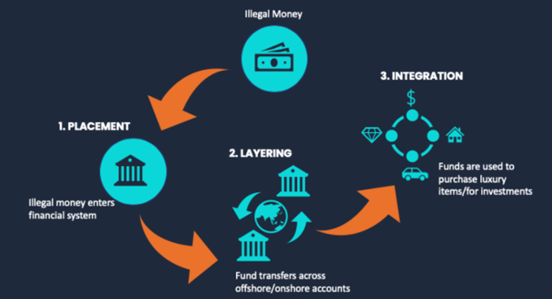
Research Background / Problem Statement
Overview: AML (Anti-Money Laundering) frameworks are essential for banks to prevent illegal income generation. Compliance failures can lead to significant penalties and reputation damage.
Traditional AML systems rely heavily on rule-based methods, leading to inefficiencies such as high false positives and inability to adapt to new laundering techniques. Modern AML detection that involves AI in place are also doing a fine job but they are still lagging in detecting true laundering transac.
Challenges: Traditional AML processes struggle with the volume and complexity of transactions and evolving laundering techniques, leading to the need for enhanced solutions.
Need for AI: Artificial intelligence offers potential advancements in monitoring, risk assessment, and regulatory reporting to improve AML efficiency and effectiveness.

Slide 4
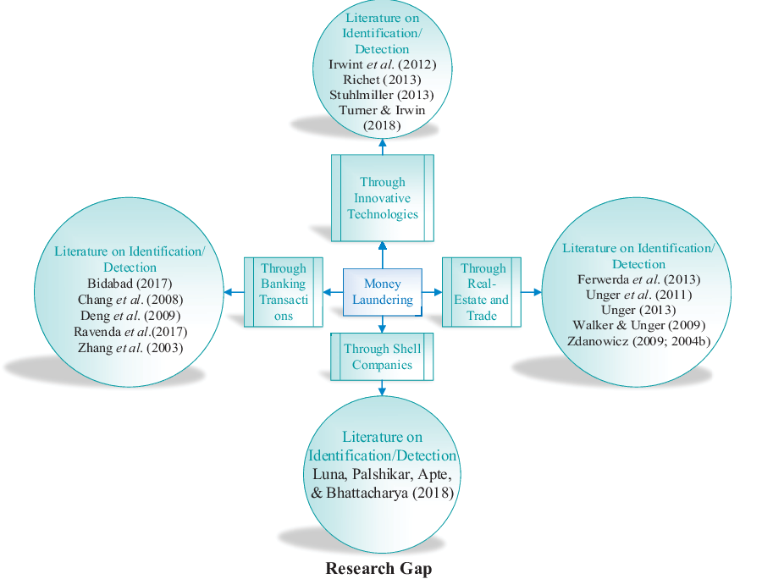
Literature Review
Overview:
Traditional AML systems struggle with scalability, adaptability, and interpretability.
AI techniques (e.g., TCNs, XGBoost, SMOTE) enhance AML detection by addressing these challenges.
Feature engineering (temporal, contextual, frequency-based) improves detection precision.
Key Insights from Studies:
Time-Frequency Analysis: Identifies laundering patterns using temporal trends (Chen & Zhao, 2021).
Active Learning: Reduces manual intervention and adapts to evolving techniques (Garcia et al., 2022).
Scalability and Real-Time Monitoring: Advanced models like TCNs and XGBoost handle large, imbalanced datasets (Brown, 2021).
Research Gaps:
Scalability: Real-time transaction monitoring remains a challenge.
Adaptability: Conventional models fail to capture emerging laundering techniques.
Data Diversity: Lack of multimodal datasets representing diverse behaviors.

Slide 5

Aim of the project
Develop a robust and scalable Anti-Money Laundering (AML) framework using advanced AI techniques.
Leverage Temporal Convolutional Networks (TCNs) and XGBoost to enhance detection accuracy and scalability.
Address class imbalance in transaction data using SMOTE to improve model precision and recall.
Implement innovative feature engineering (e.g., temporal trends, sender-receiver profiling) for better detection of laundering patterns.
Focus on creating an adaptable system capable of identifying emerging and complex laundering techniques.
Perform temporal and behavioral analysis to detect intricate sequential transaction patterns.
Improve the efficiency of AML processes while reducing compliance costs for financial institutions.

Slide 6

Research Questions
Research Questions:-
How can machine learning models such as XG Boost and Random Forest & Deep learning models such as Temporal Convolutional Networks (TCNs) and TCN’s with attention mechanisms and XGBoost improve transaction monitoring transaction monitoring detection accuracy in the domain of Anti Money Laundering , particularly in imbalanced datasets?
How can advanced data augmentation techniques, such as SMOTE be used to optimized to address class imbalance while preserving the integrity of rare laundering patterns in highly imbalanced datasets?
What is the impact of engineered temporal and contextual features, such as transaction frequency patterns and risk-based sender-receiver profiling, on enhancing model performance and scalability in large-scale financial systems?

Slide 7
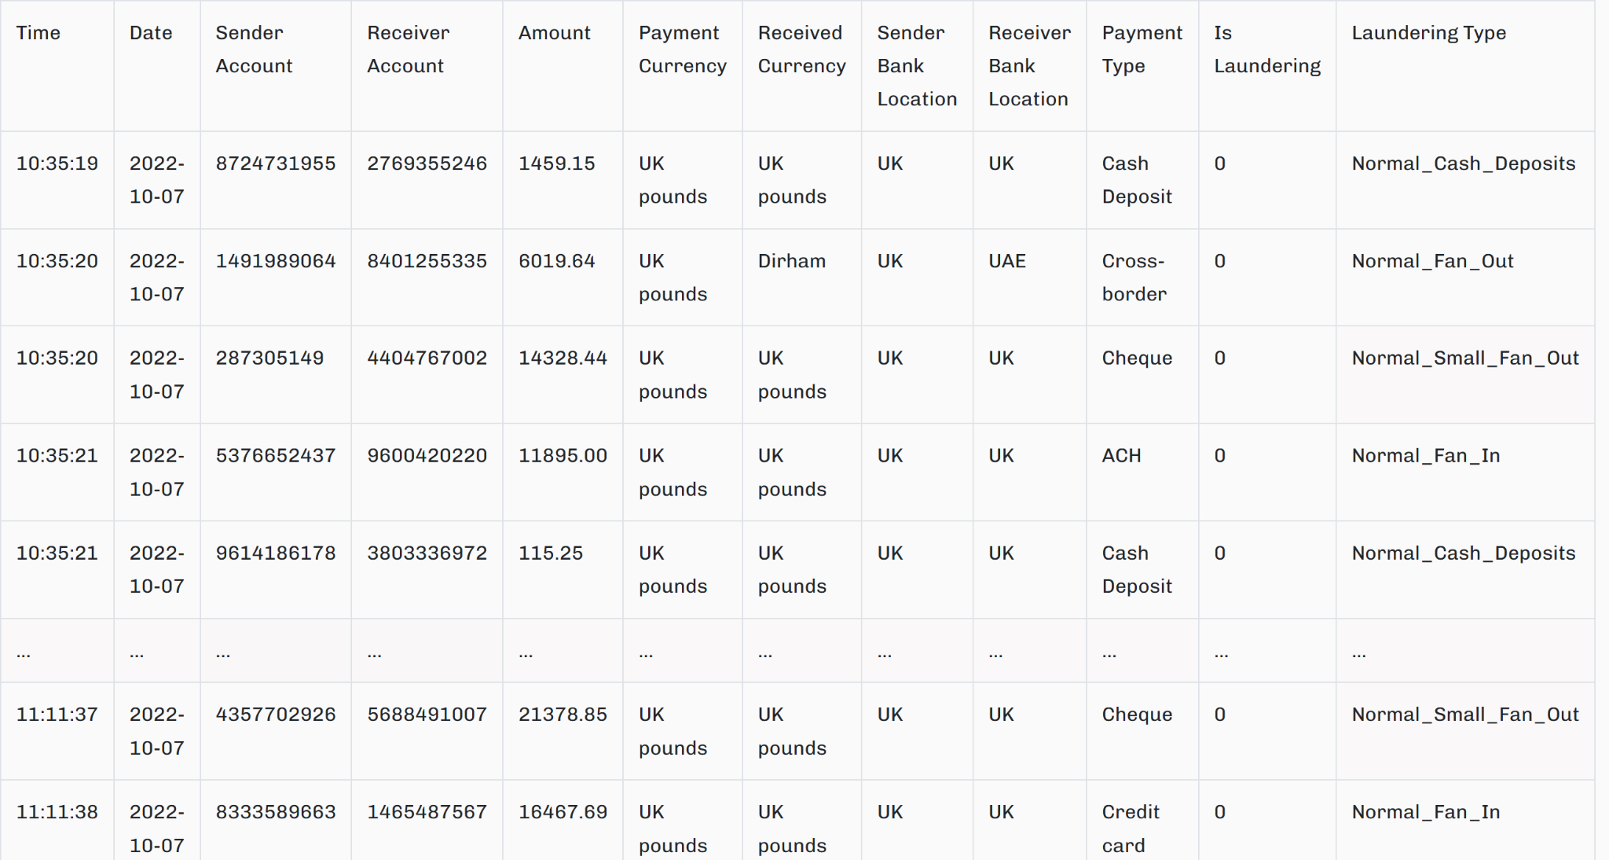
Raw Dataset Introduction & Analysis
Dataset Overview:
Name: SAML-D Synthetic Dataset (Kaggle).
Size: 9.5 million transactions with 12 raw features.
Attributes: Temporal, behavioral, geographic, and contextual data.
Dataset Challenges:
Class Imbalance: Less than 1% of transactions flagged as laundering.
Skewed Distributions: High variability in transaction amounts and frequency.
Outliers: Significant anomalies detected in transaction volumes and frequencies.
Analysis Results:
Temporal analysis revealed spikes in suspicious activities during specific periods.
Correlation analysis identified key predictors of laundering patterns.
Behavioral profiling highlighted high-risk accounts and unusual transaction patterns.

Slide 8
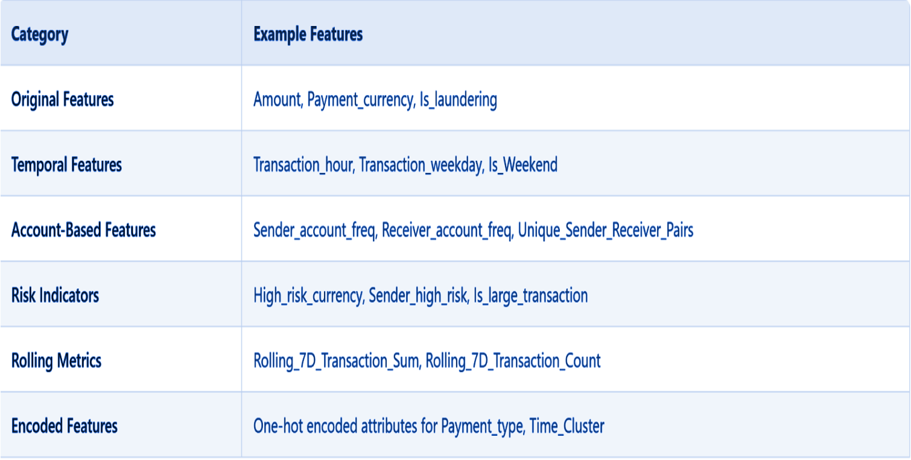
Processed Dataset Introduction & Analysis
Preprocessing Steps
Normalization: Addressed skewness in transaction amounts.
Outlier Handling: Removed extreme anomalies to improve model performance.
Encoding: Categorical variables (e.g., country, currency) transformed into numerical formats.
Feature Engineering
Temporal Features:
Time of transaction (hour, day, week).
Temporal clusters to detect suspicious activity patterns.
Behavioral Features:
Sender-receiver frequency ratios.
Average transaction amounts compared to historical data.
Risk Indicators:
High-risk countries and currencies flagged.
Refined Dataset Insights
Expanded dataset to 115 engineered features.
Enhanced predictive power for identifying suspicious patterns.
Improved dataset quality ensured better model performance on imbalanced data.

Slide 9

Methodology
Framework: CRISP-DM (Cross-Industry Standard Process for Data Mining).
Feature Engineering:
Temporal patterns (e.g., transaction time clusters).
Sender-receiver frequency ratios for behavioral insights.
Modeling:
Machine Learning: Random Forest & XGBoost for robust classification.
Deep Learning: Temporal Convolutional Networks (TCNs) for sequential data.
Imbalance Handling: SMOTE to address class imbalance in laundering cases.
Evaluation: Accuracy, precision, recall, and ROC-AUC metrics to measure performance.

Slide 10
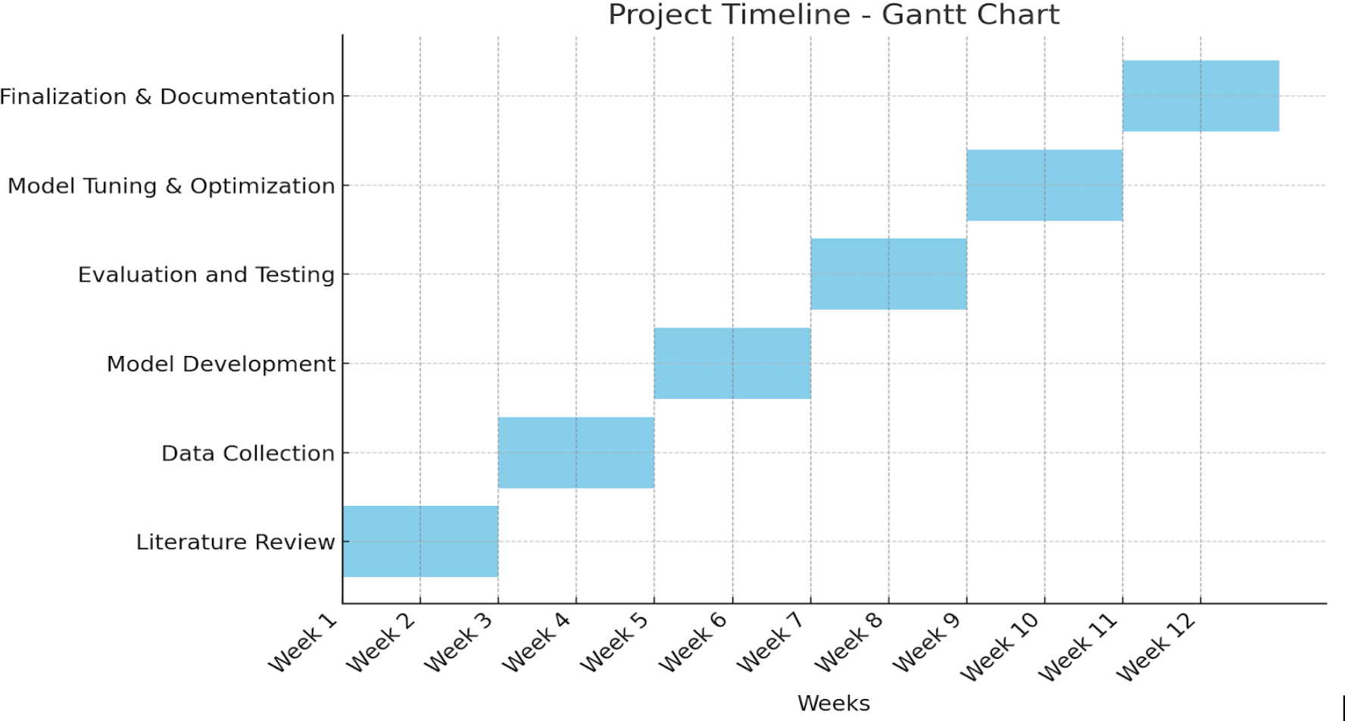
Project Timeline

Slide 11
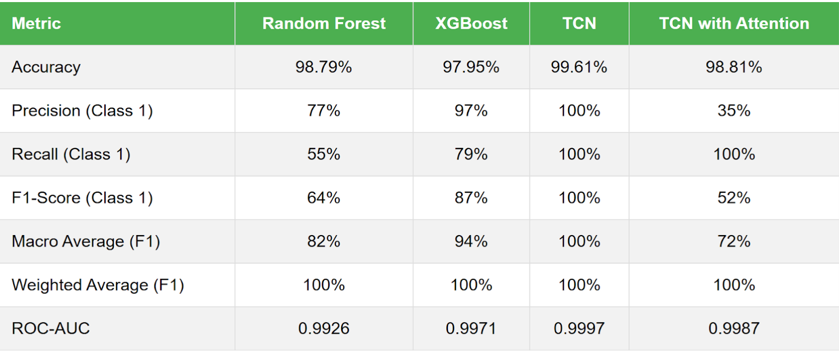

Outcomes and Results Obtained (Classification Report)

Slide 12
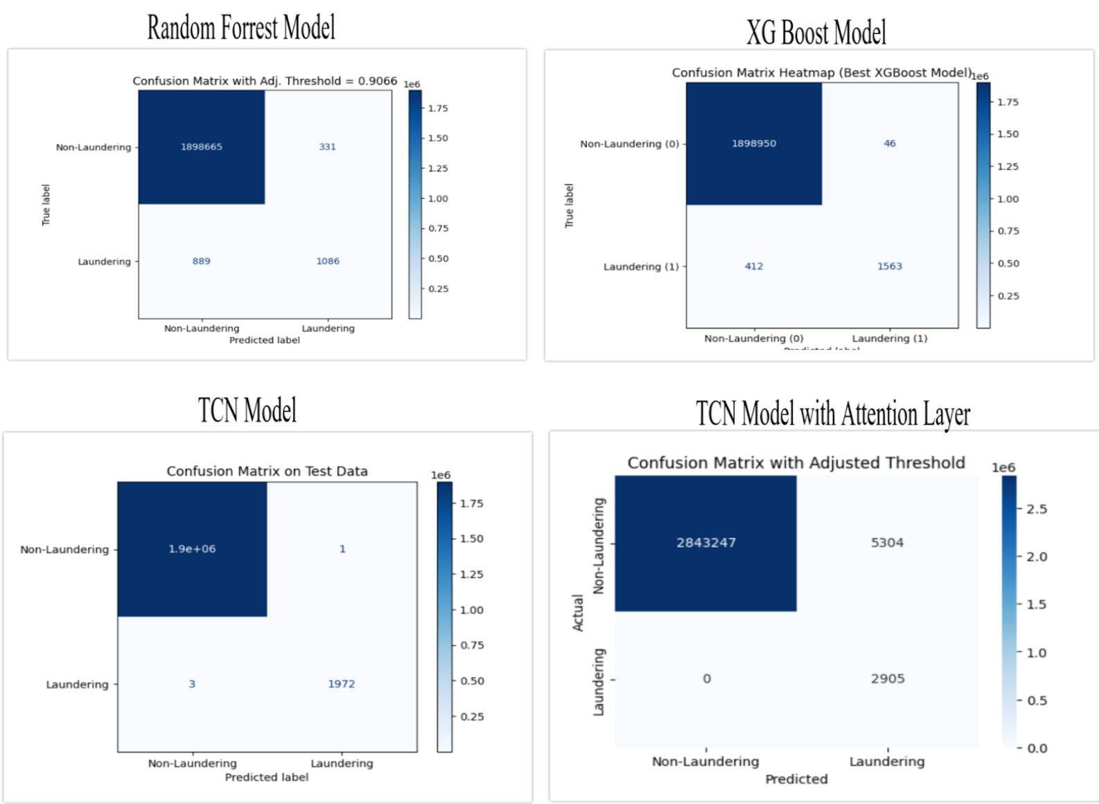
Outcomes and Results Obtained (Confusion Matrix)

Slide 13
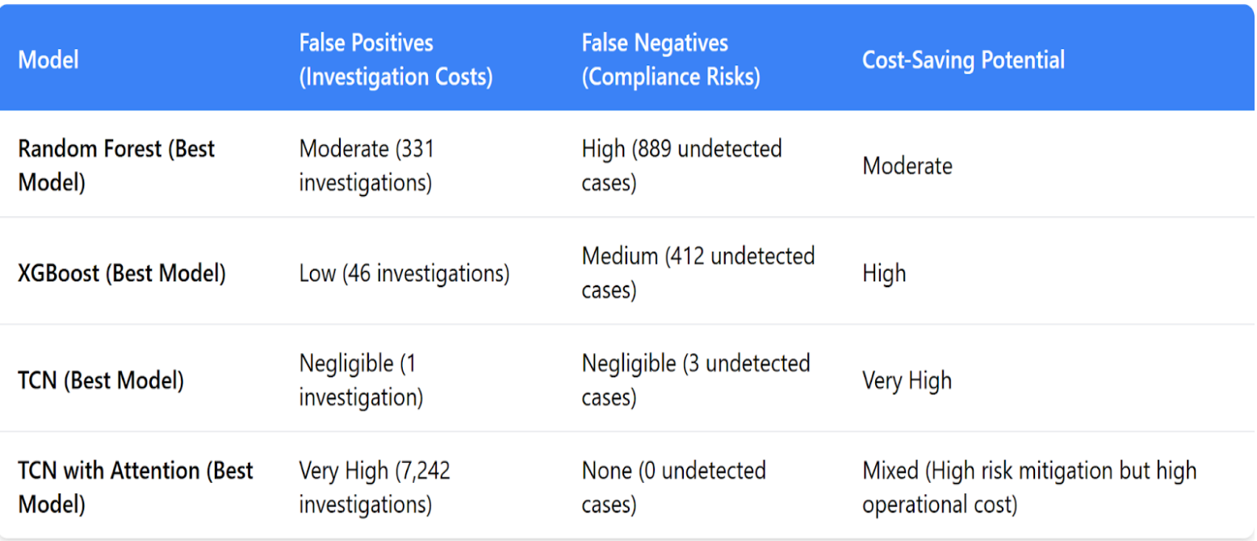
Outcomes and Results Obtained (Economic Impact)

Slide 14
Conclusion
Best Performing Model:
TCN achieved the highest accuracy (99.61%), perfect precision, recall, and ROC-AUC, making it the most effective and well-rounded model for detecting money laundering.
Cost-Effectiveness:
TCN minimized both false positives (1) and false negatives (3), significantly reducing operational and compliance costs.
XGBoost provided a strong balance between precision (97%) and recall (79%), making it a cost-effective alternative.
Model-Specific Insights:
Random Forest demonstrated high accuracy (98.79%) but struggled with recall, missing a significant number of laundering cases.
TCN with Attention achieved perfect recall (100%) but produced excessive false positives (7,242), leading to higher operational expenses.
Recommendations:
TCN is ideal for organizations requiring highly accurate and efficient AML systems.
XGBoost is a practical choice for environments prioritizing cost-efficiency and operational balance.
TCN with Attention may suit compliance-focused scenarios where eliminating false negatives is critical, despite increased operational costs.

Slide 15


